Slide 1

-Shiva Chunbuk -A Bhumika Rao -Sanjana Netam
SMART
MUSHROOM
FARMING
SMART
MUSHROM
FARMING

Slide 2
IoT application
The temperature, humidity, light intensity and CO2 are some of the important parameters need to manage in a mushroom farm and these data are collected through wireless sensors. The implementation of this smart mushroom system have optimized the usage of resources such as water and fertilizer and will also maximized the quality and productivity of the mushroom.

Slide 3
Problem
Manpower is needed to ensure environment conditions of mushroom cultivation and there are many factors to successfully develop mushroom cultivation appropriate. Environmental conditions must be maintained to enable profitable growth and business.
IoT can help to improve agricultural and farming industries by reducing labor cost through automation and increase the yield by providing optimum conditions for growth.

Slide 4
Methodology
The temperature & humidity sensor (DHT11) sends the temperature & humidity value to our controller.
There is also a light sensor which monitors the light intensity and sends status value to the controller.
We are using ESP-8266 as main controller this is where all input parameters are received and processed for automation.
ESP-8266 monitors the environment with its sensors and if needed it can control the environment temperature & humidity.

Slide 5
We also focused on IoT just for testing. Whenever the ESP-8266 is powered it automatically connected with available WIFI .
The IoT feature is only active when the light intensity is high. On that situation the device will just send a “POST” request to the server to notify the light status alert to the user.

Slide 6
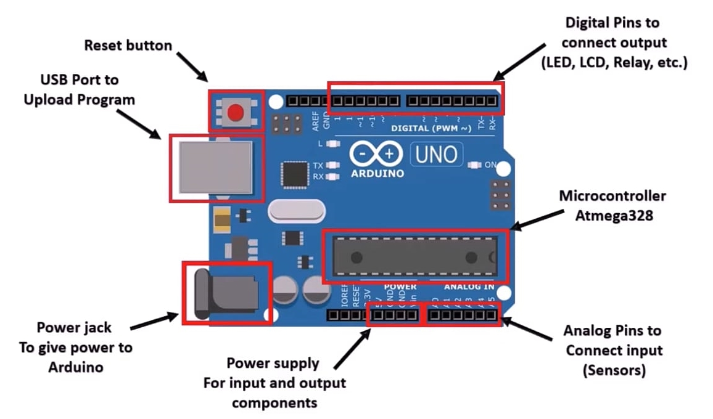
Component Used
Arduino UNO- The Arduino Uno is an open-source microcontroller board based on the ATmega328p microchip microcontroller . The board is equipped with sets of digital and analog I/O pins that may be interfaced to various expansion boards (shields) and other circuits

Slide 7
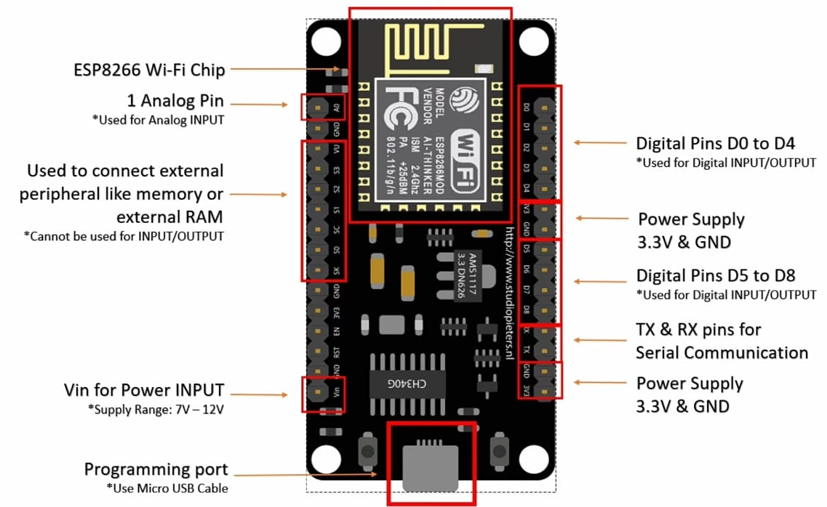
ESP8266- The ESP8266 Wi-Fi Module is a self contained SOC with integrated TCP/IP protocol stack that can give any microcontroller access to your Wi-Fi network. The ESP8266 is capable of either hosting an application or offloading all Wi-Fi networking functions from another application processor.

Slide 8
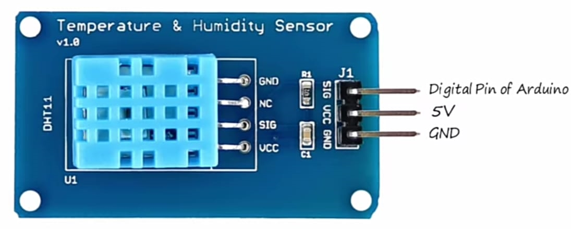
DHT11 - The DHT11 is a basic, ultra low-cost digital temperature and humidity sensor. It uses a capacitive humidity sensor and a thermistor to measure the surrounding air, and spits out a digital signal on the data pin (no analog input pins needed). It's fairly simple to use, but requires careful timing to grab data.

Slide 9
LDR Light Sensor-The most common light sensor type that’s used in a light sensor circuit are photoresistors, also known as a light-dependent resistor (LDR). Photoresistors are used to simply detect whether a light is on or off and compare relative light levels throughout a day.

Slide 10
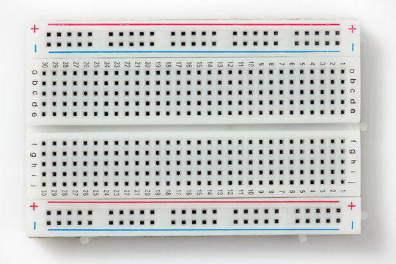
Breadboard -A breadboard (sometimes called a plug block) is used for building temporary circuits. It is useful to designers because it allows components to be removed and replaced easily.

Slide 11
Strength:
IoT-based smart mushroom farming is built for monitoring the crop field with the help of sensors like light, humidity, temperature, and soil moisture, etc and automating the irrigation. IoT is highly efficient when compared with the conventional approach.
Weakness:
The IoT – smart mushroom needs availability on the internet continuously. The rural part of the developing countries... The IoT based equipment requires the farmer to understand and learn the use of technology. This is the main challenge in... The system offers .

Slide 12
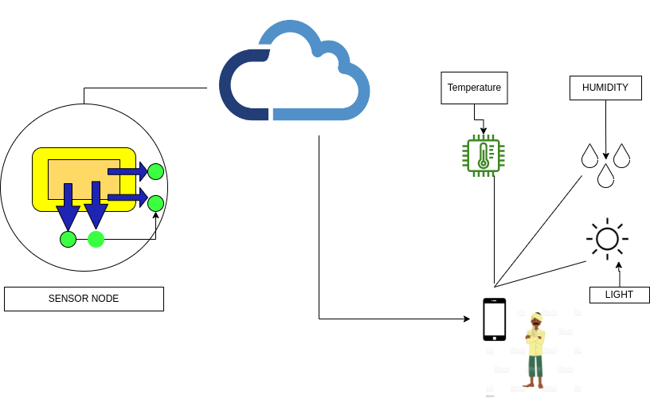
Block Diagram

Slide 13
Sensor Node Diagram
POWER SUPPLY
CLOUD
TEMPERATURE
HUMIDITY SENSOR
IoT
AURDUINO UNO
BOARD
SOIL MOISTURE SENSOR
MOBILE APPLICATION
LIGHT SENSOR
ESP8266
FARMER

